Slide 1
Generate Ninja 101

Slide 2
What is Ninja Build
Ninja is a small build system with a focus on speed

Slide 3
What is GN ?
GN is a meta-build system that generates build files for Ninja.
Meta-build system provides platform-independent script to generate build script depending on the platform

Slide 4
Basic Usage
Gn gen [output dir path]
Ninja –C [output dir path] [target name]

Slide 5
How GN generate Ninja build file?
GN goes through all BUILD.gn files starting from the top level, pick up all the targets defined in there, then move to the next level recursively

Slide 6
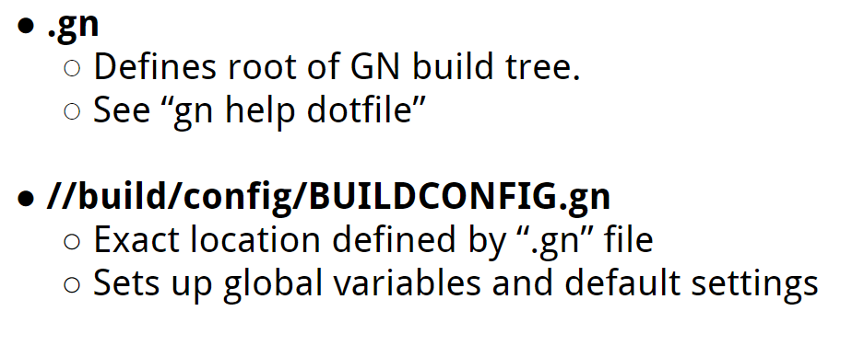
How GN generate Ninja build file?

Slide 7
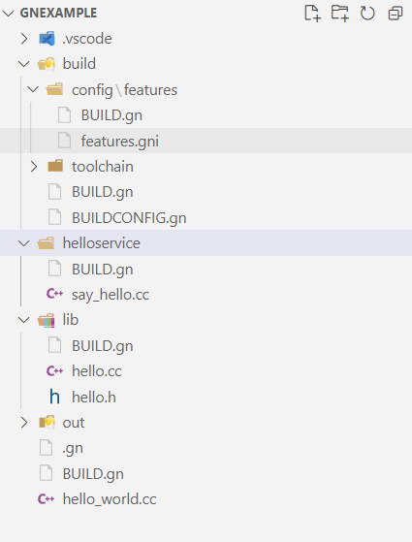
How GN generate Ninja build file?

Slide 8
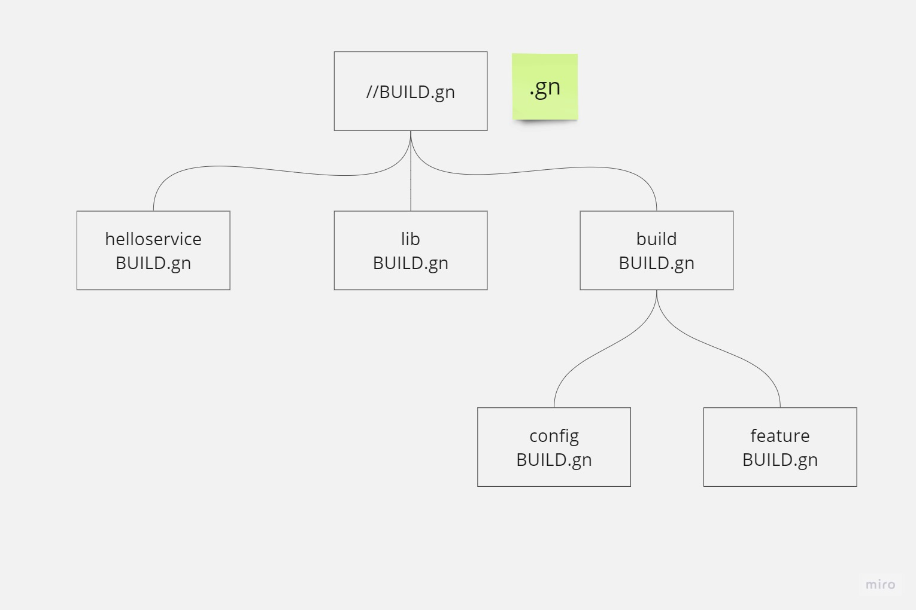
Build tree

Slide 9
Targets
Built-in target types: executable, shared_library, static_library
group: a named group of targets
Config: configuration objects can be applied to targets and specify sets of compiler flags, includes, defines, etc.

Slide 10
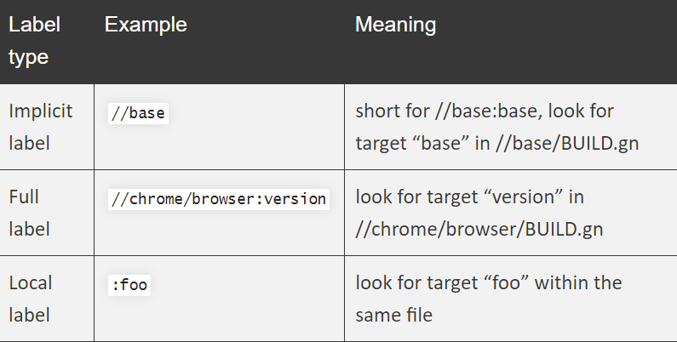
Labels

Slide 11
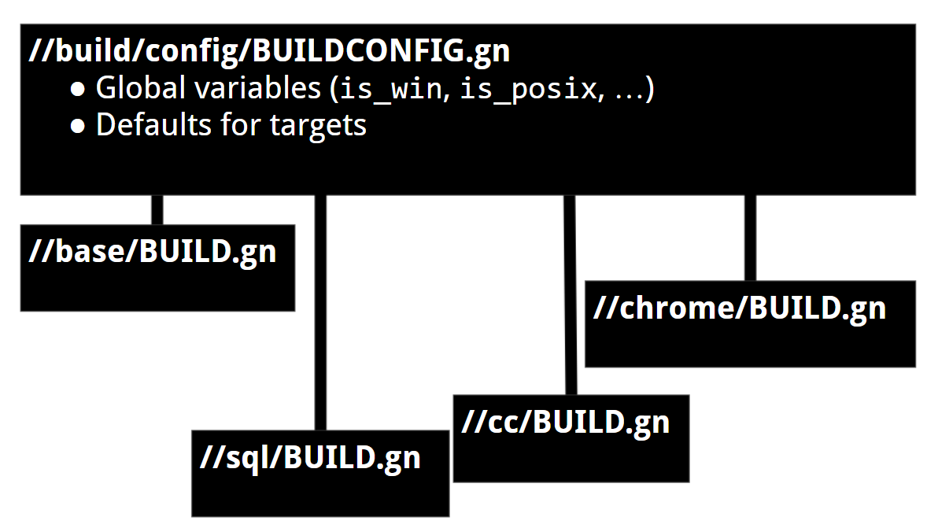
Toolchains

Slide 12
GN Help
Gn help

